Slide 1


CSL Competition
Electornic Devices Makret
Members List
WEI Rongyan
Chan Tai To
Xue Kaiwen
Li Haotian

Slide 2
Executive Summary
1. Web Crawling
1.1 Website Observation
1.2 Methodology used
2. Findings
2.1 Data Brief Introduction
2.2 Sales Analysis
2.3 Findings

Slide 3
Web Crawling

Slide 4
1.1
Web Crawling- Observation
Investigation:
Both Suning and HKTVMall use Javascript to render dynamic pages
Both sites provides useful attributes such as price, name, brand, and comment summary
Normally business sites has some anti-crawling function, preventing flooding HTTP requests
HKTVMall’s URL has some rules for products from the same category while Suning doesn’t

Slide 5
1.1
Web Crawling- Observation
Investigation:
Both Suning and HKTVMall use Javascript to render dynamic pages
Both sites provides useful attributes such as price, name, brand, and comment summary
Normally business sites has some anti-crawling function, preventing flooding HTTP requests
HKTVMall’s URL has some rules for products from the same category while Suning doesn’t

Slide 6
1.2
Web Crawling- Methodology used
Methodology:
Jupyter notebook as programming environment (Python3)
Pyppeteer, a Python framework able to render Javascript automatically
Beautifulsoup, a Python library providing functions to examine HTML and XML files
Design two csv files for each website, containing the most useful information
Use the csv file headers to find relevant data from the website

Slide 7
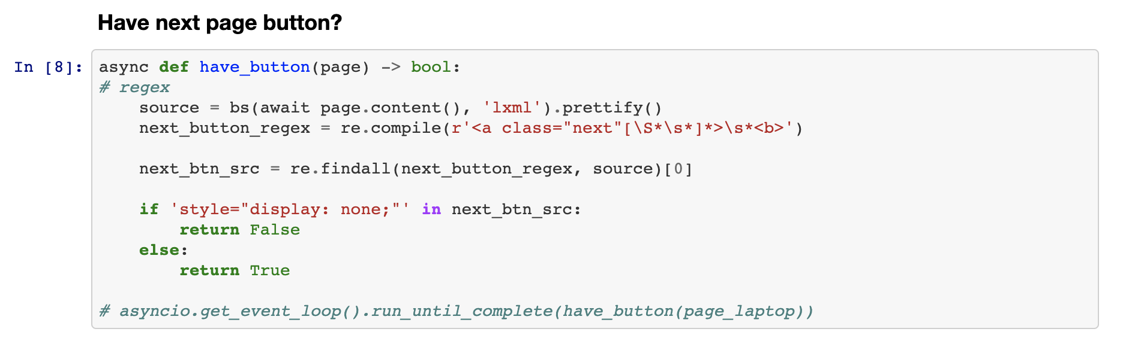

1.2
Web Crawling- Methodology used
Suning
Cannot determine current page number by examining URLs
Find the button that points to the next page. If that button does not exist, the current page is the last page
For each category, fetch all URLs for that category
Then traverse the URLs to crawl data
One of the top ten hot products in Suning

Slide 8
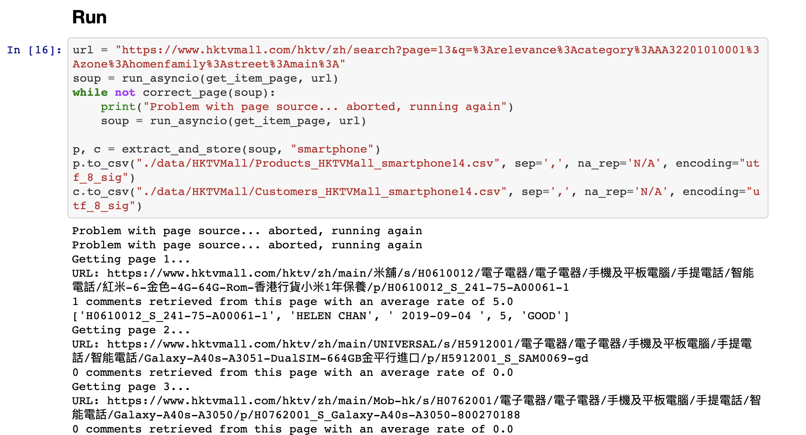
1.2
Web Crawling- Methodology used
HKTVMall
HKTVMall’s URLs are well indexed
Get the total number of pages before crawling each page
Then use the rules in the URL to get the content of each page
Sometimes the respond page cannot be rendered by Javascript correctly
Need to write a exception handler to request the page again when the page is incurrent

Slide 9
Data Analysis

Slide 10
2.1
Data Brief Introduction - Price & Product Variety
Product offered by different suppliers
Multiple alternatives comparison
—> sufficient information provided
High competitiveness
—> risk of quality measurement issue
Price variety within same product
Customer bargaining power increased
—> preferential purchasing decision
Notes:
preferential purchasing decision

Slide 11
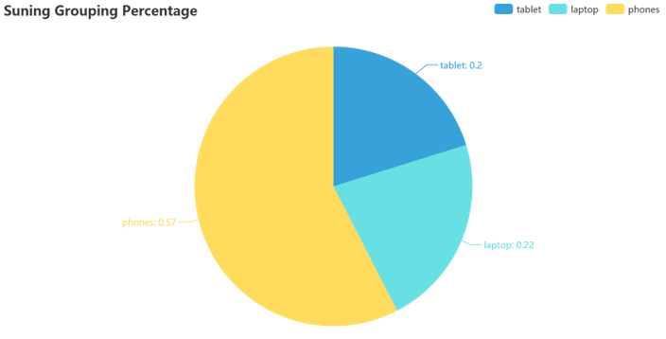
2.1
Data Brief Introduction – Product varieties
Product offered by Suning
Less options
Good quality measurement
--> build up the reputation
Stable price
Lower bargaining power

Slide 12
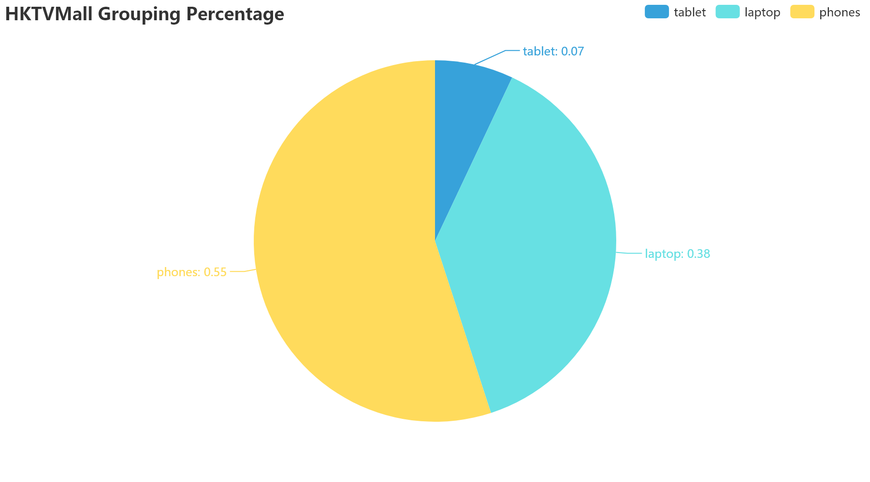
2.1
Data Brief Introduction – Product Varieties
Product offered by different suppliers
Multiple alternatives comparison
—> sufficient information provided
High competitiveness
—> risk of the quality measurement issue
Price variety within the same product
Customer bargaining power increased
—> preferential purchasing decision

Slide 13
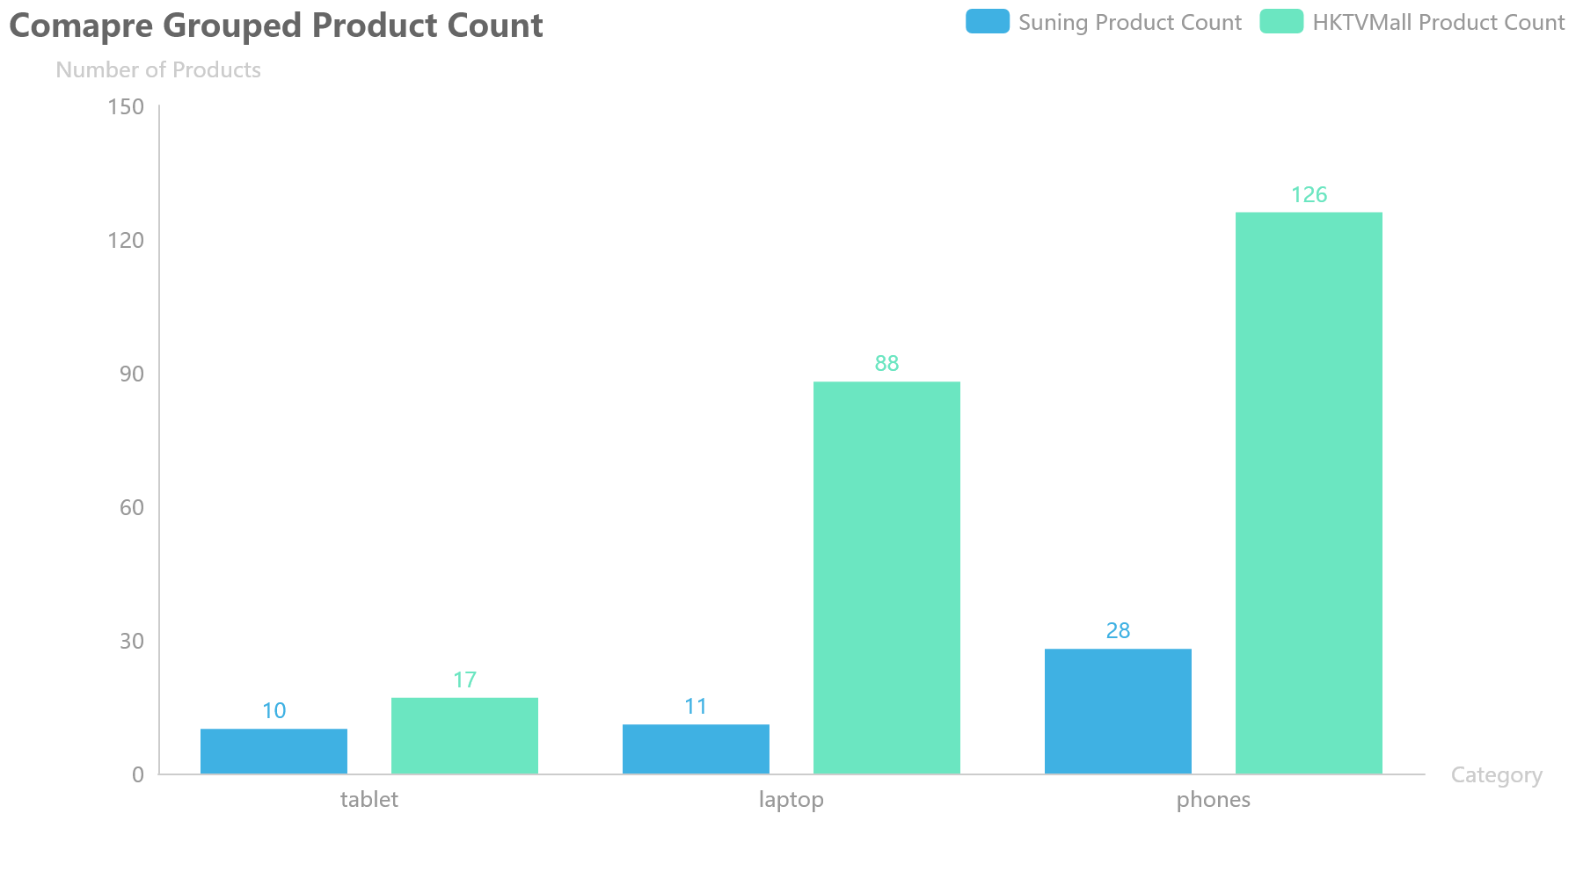
2.1
Data Brief Introduction – Product Varieties Comparison

Slide 14
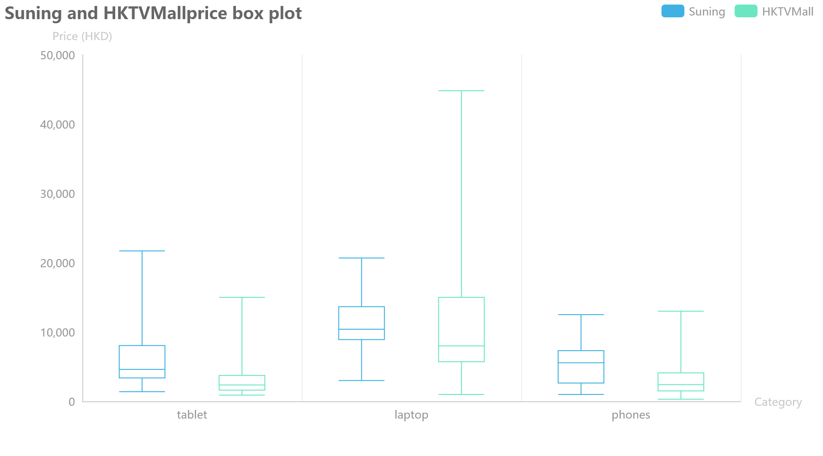
1.1
Data Brief Introduction – Price distribution

Slide 15
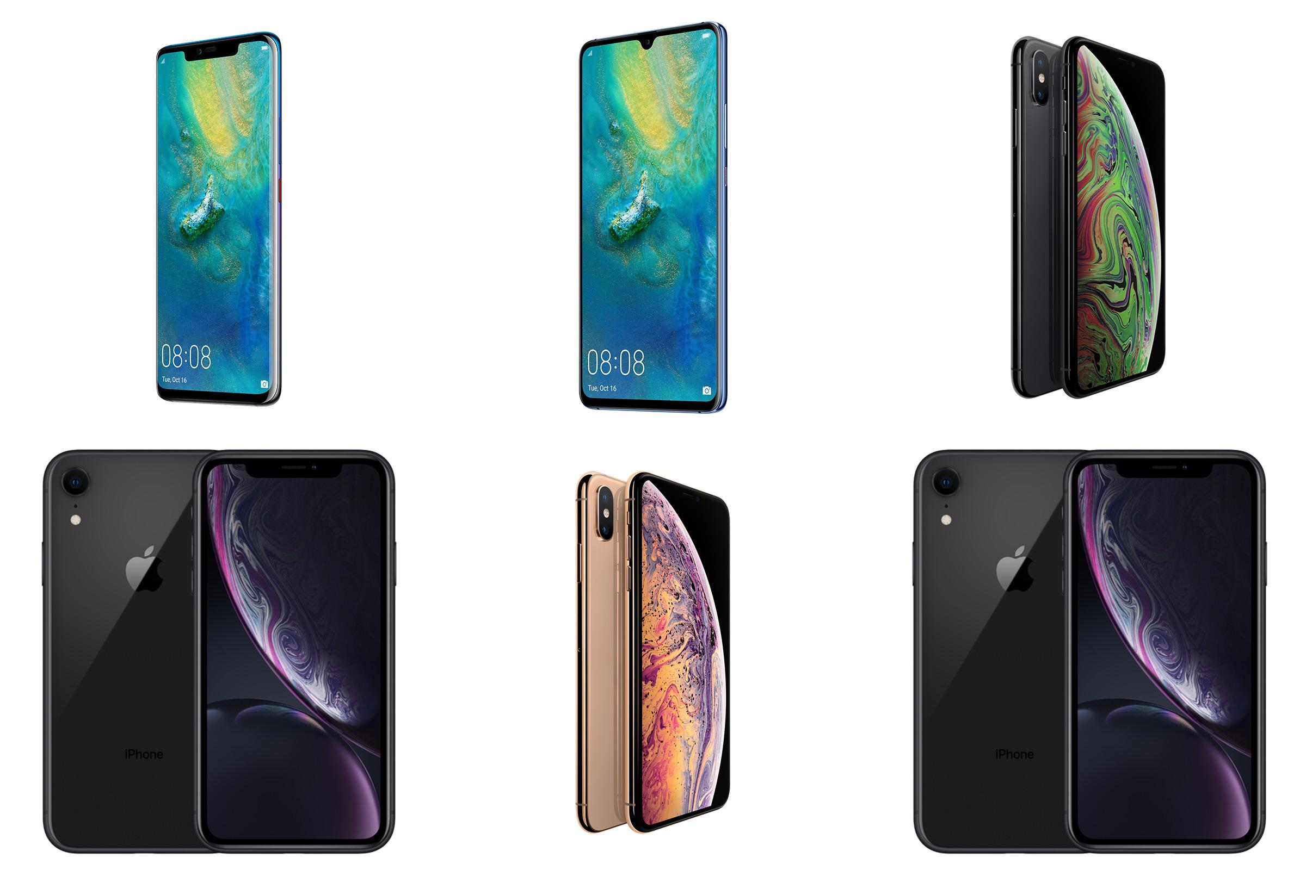
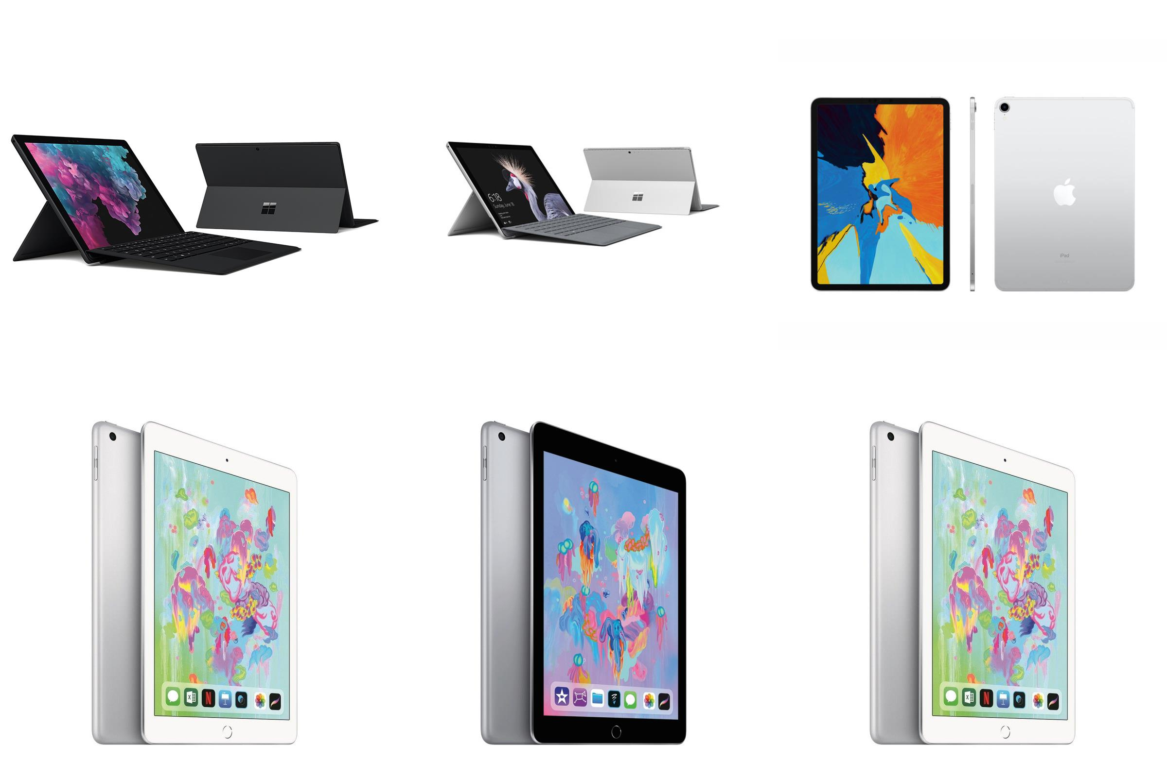
2.1
Product Function and Design Analysis
- Full screen design
- No home button
Top 6 Sales Phones in Suning
- 2 in 1 usage
- Lightweight, easily carry
- Cooperate with the pencil
Top 6 Sales Tablets in Suning

Slide 16

2.1
Data Brief Introduction – Product Function Analysis
Brand Effect
Fluid System
Top 6 Sales Laptops in Suning

Slide 17
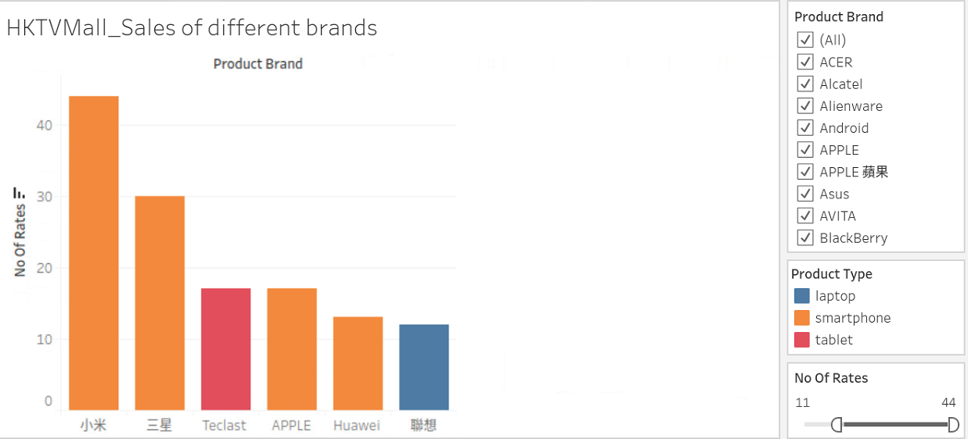
2.1
Brand Effect on Sales

Slide 18
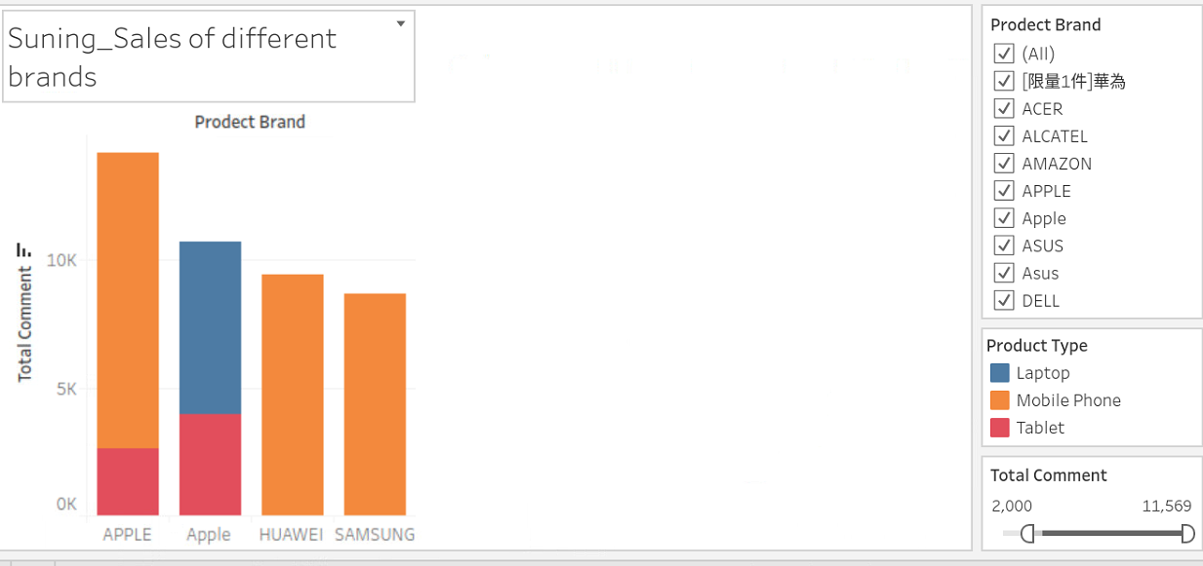
2.1
Brand Effect on Sales

Slide 19
2.1
Sales Analysis – Price Factors (Regression Analysis)

Slide 20
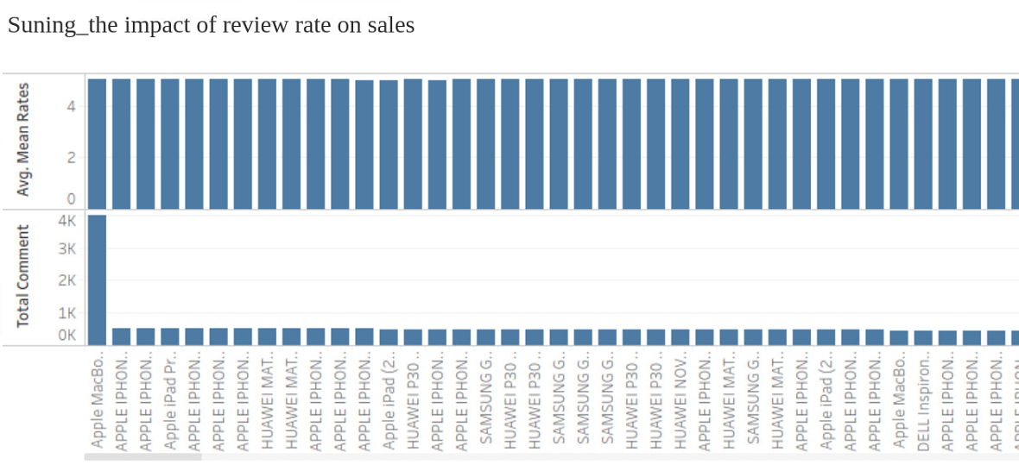
3.1
Sales Analysis – Review rate and amount
The sales doesn't rely on the reviwe rate

Slide 21
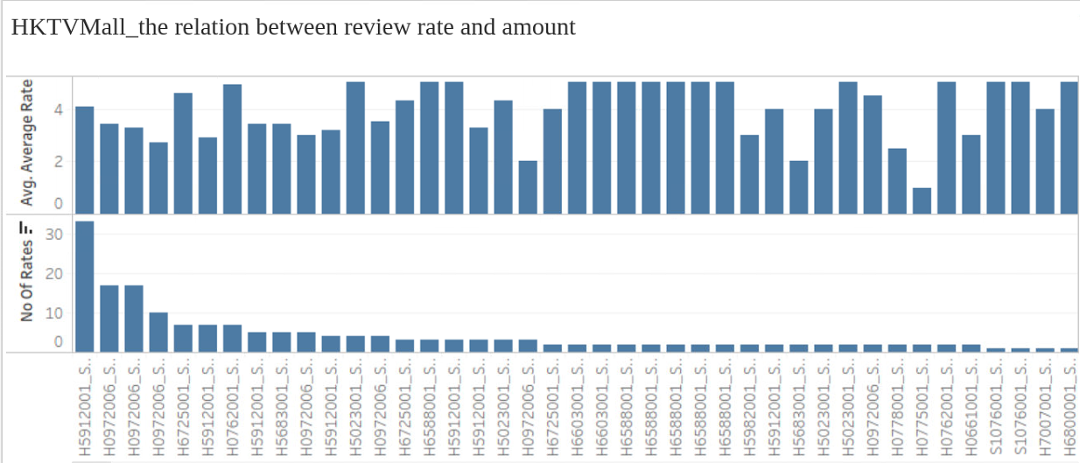
3.1
Sales Analysis – Review rate and amount
Meaningless rating score
If the sales is lager enough, the rate can be regarded as a refernecess

Slide 22
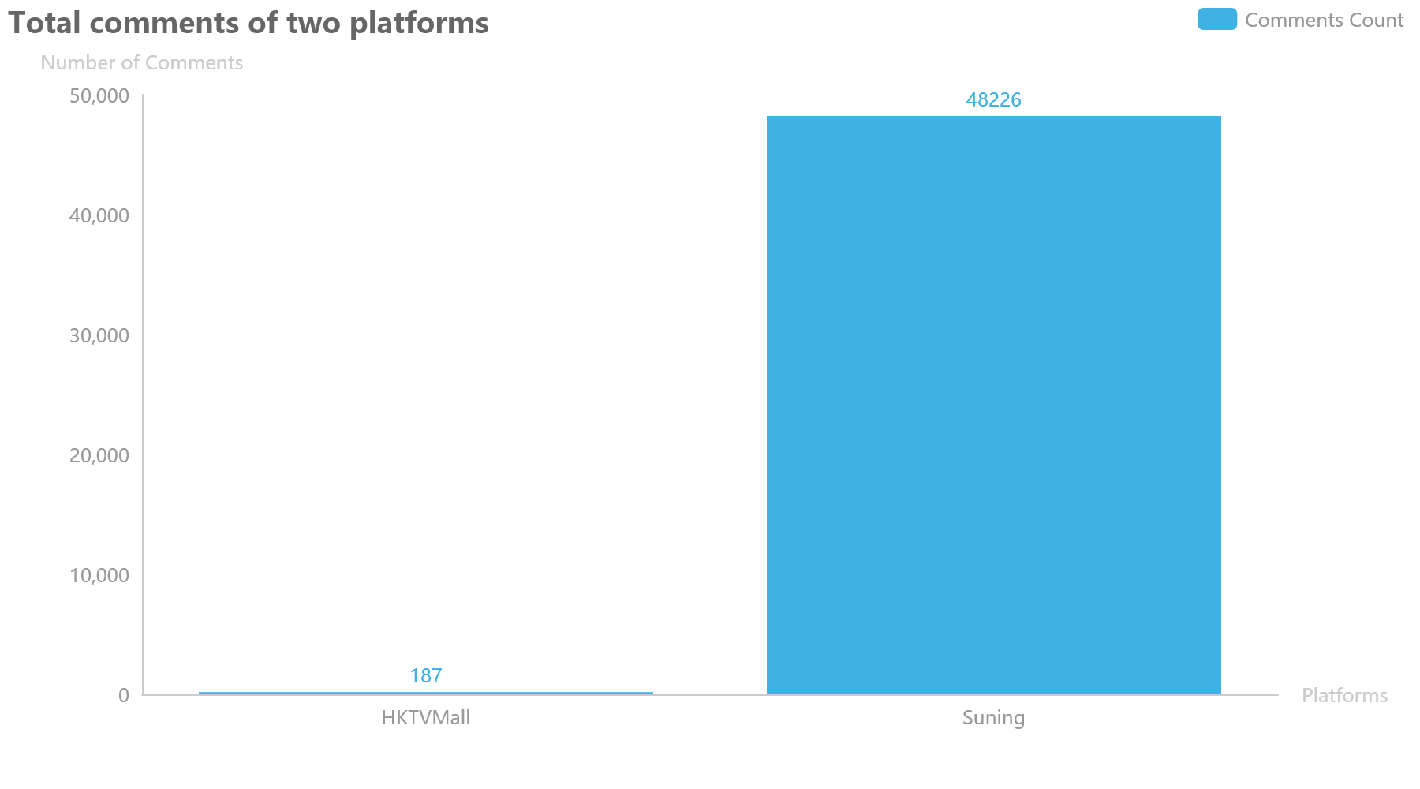
3.1
Sales Analysis – Review Analysis
Mandatory Comment Regulation in Suning platform

Slide 23
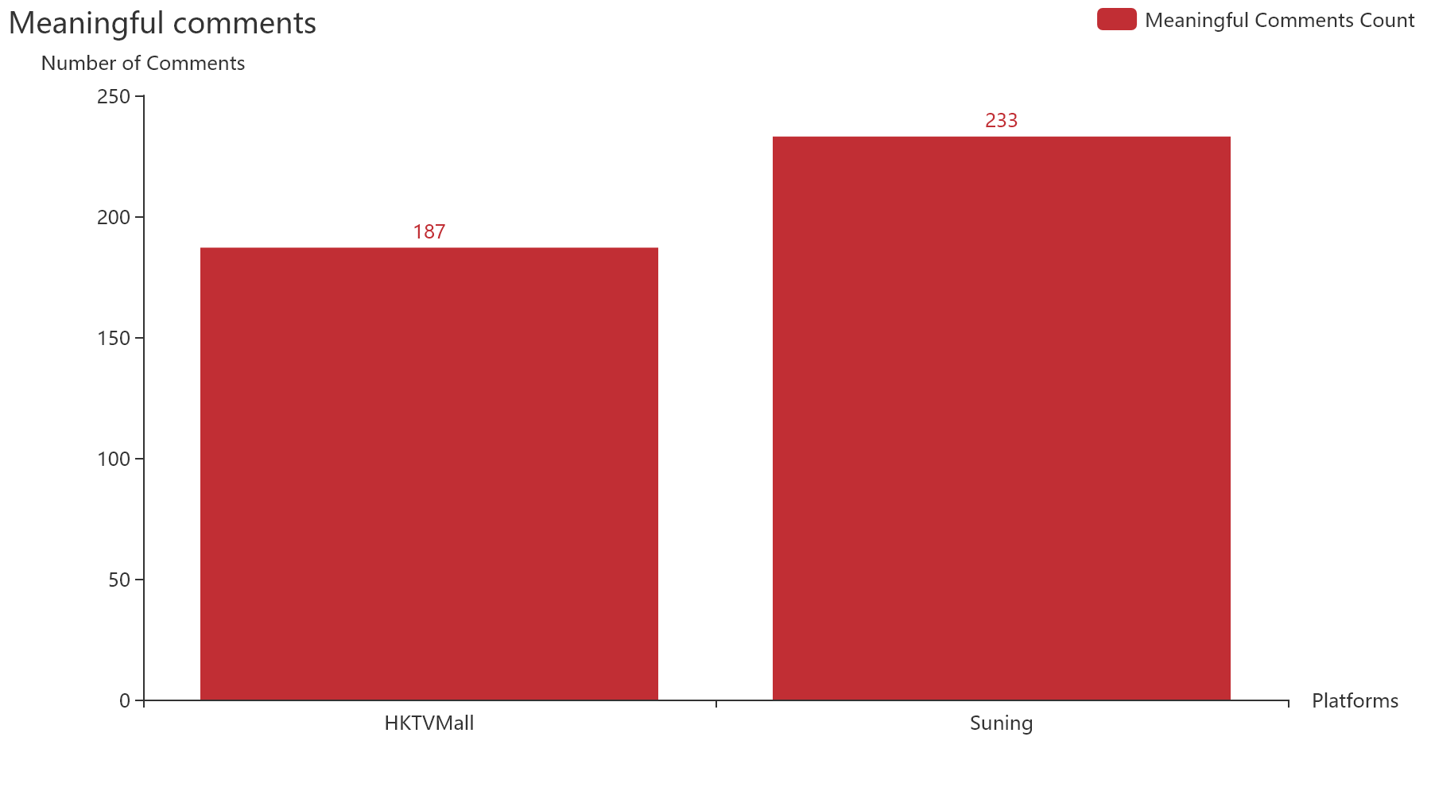
3.1
Sales Analysis – Review Analysis

Slide 24
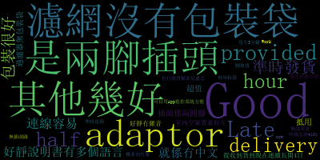
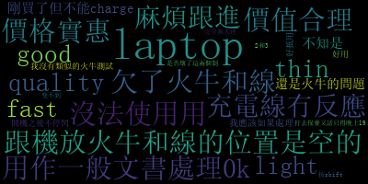
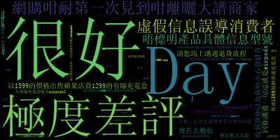
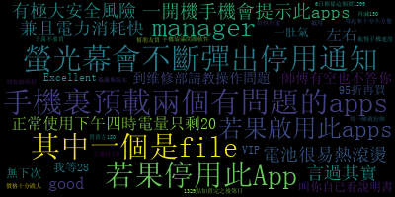
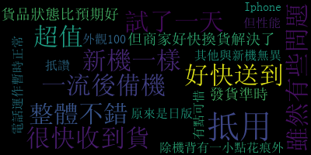

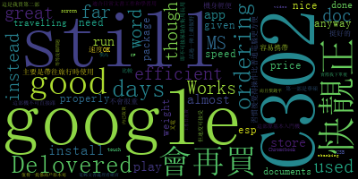

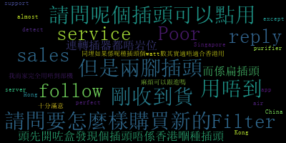
2.3
Reviwe Analysis - Customer Sentiment

Slide 25
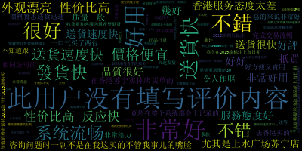
2.3
Reviwe Analysis - Customer Sentiment

Slide 26
2.3
Reviwe Analysis - Summary
 | HKTVMall | Suning
Customer services | - smooth communication - fast devilry - unperfect packing | - bad communication - fast devilry
Electronic devices quality | - battery run out fast - potential security risk in the Apps - the devices cannot work | - good quality
Customer purchasing experience feeling | - exceed the expectation - good price | - positive reaction with products - negative reaction with retailers' services

Slide 27
2.2
Findings – Uniqueness
Compulsive customer comment
--> collect information from the buyers
--> significant evaluation for others
Products and services guarantee
--> increased satisfaction of shopping
--> build up the reputation of company
An intermedia role during transaction
--> no operation cost
--> a lot variety of merchandise
The calculation of profitability
--> cheaper merchandise price
--> higher delivery cost

Slide 28
2.3
Conclusion

